Slide 1

MILESTONE 2
Gesture Recognition and Distance Measurement
Mentor : Dr. D.Bhanu Prakash
Presented by: MAJJI HARI KRISHNA

Slide 2

PROBLEM STATEMENT
Hands detection and extract landmark coordinates in real time.
Gestures will be classification based on this distance to represent control actions.
The distance between finger tips will be calculated.
Output :
Hand landmarks overlayed on the video stream
Live camera feed with gesture annotations
3

Slide 3
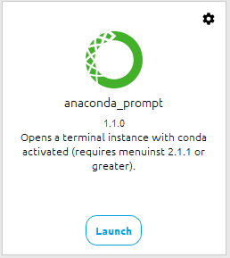
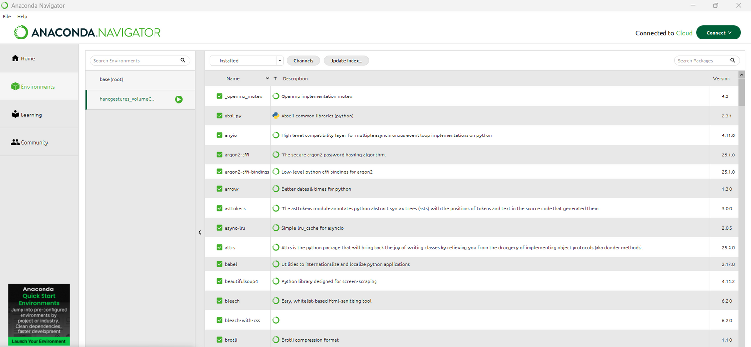
Environment setup
Open Anaconda Prompt (as normal user) and run these commands line-by-line.
1. Create a fresh conda environment with Python 3.10:
>>> conda create -n <Environment Name > python=3.10 -y
>>> conda activate <Environment Name >
2. (Recommended) make sure conda-forge channel is available for packages:
>>> conda config --add channels conda-forge
>>> conda config --set channel_priority flexible
3

Slide 4
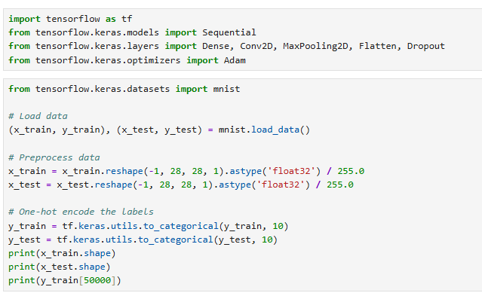
3. TensorFlow, developed by Google, is an open-source platform that provides a comprehensive ecosystem for machine learning.
>>> pip install tensorflow
Keras, now fully integrated into TensorFlow, offers a user-friendly, high-level, API for building and training neural networks.
Training a neural network involves several steps, including data,preprocessing, model building, compiling, training, and evaluating the model.
3

Slide 5
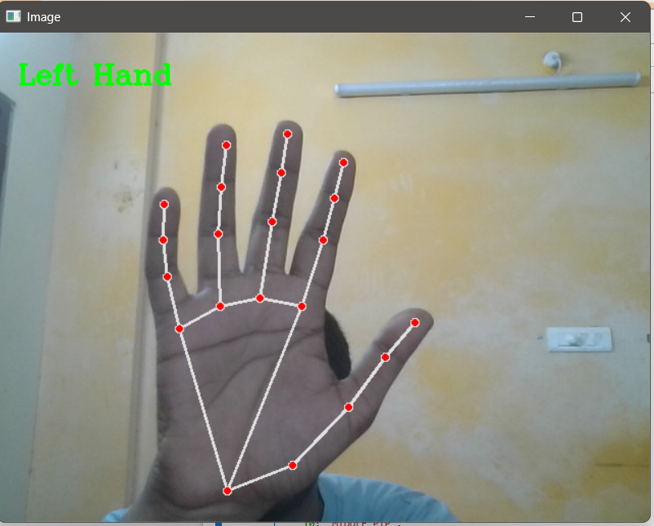
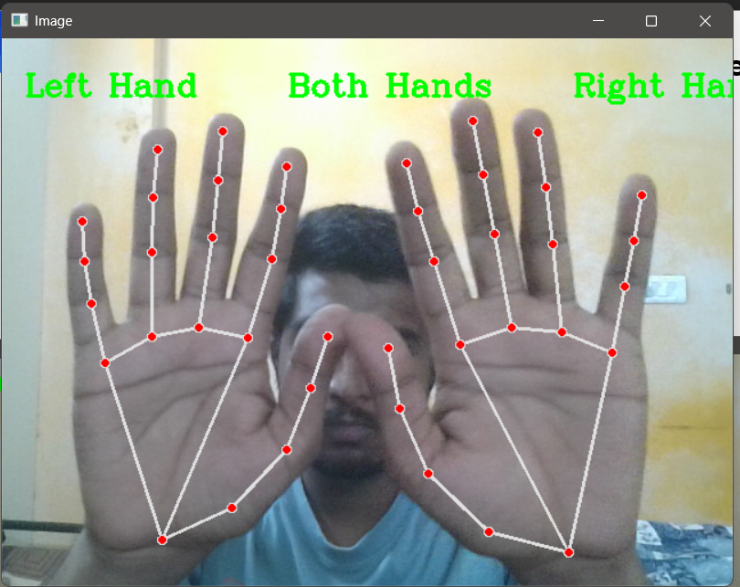
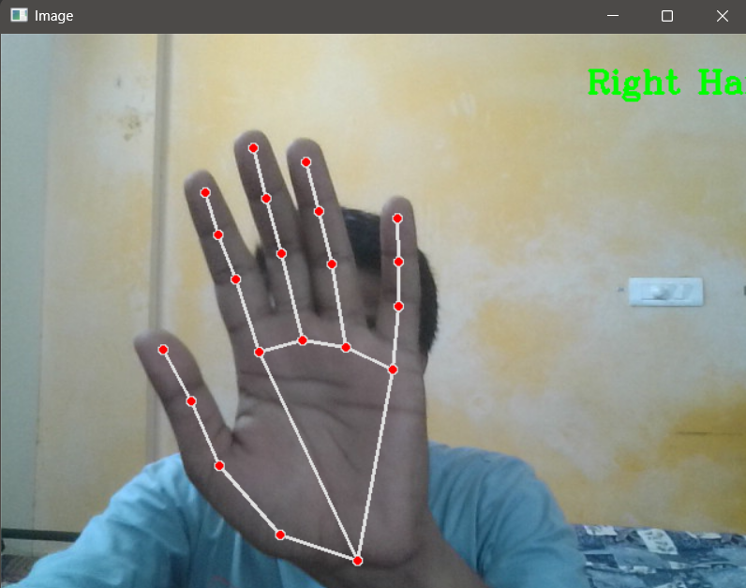
HAND DETECTION AND LABELING
INPUT : Hand Image (RGB)
Convolutional Layers
Flatten layer
Fully Connected Layers
OUTPUT: Left hand / Right hand (label with probability/ confidence)
Implementation with CNN :
Tensorflow / Keras Mediapipe Hands
PALM DETECTION – Single Shot Detection model
- Detects objects with bounding box
7

Slide 6
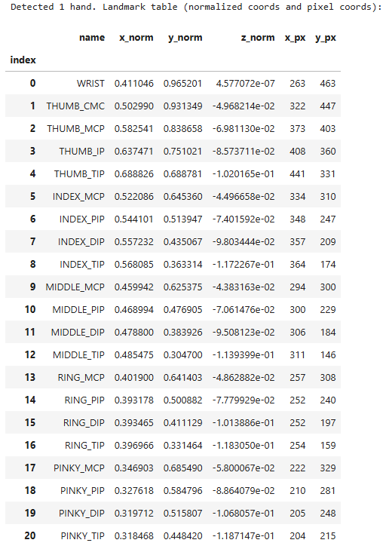
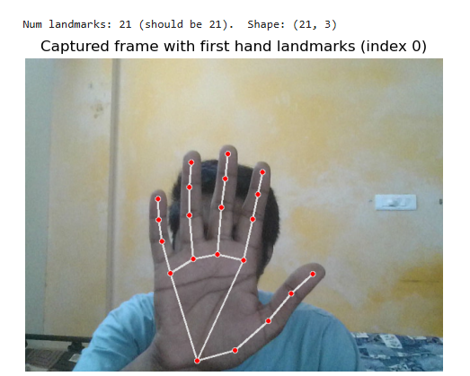
GENERATING HAND LANDMARK TABLE AND ANNOTATED OUTPUT
MEDIAPIPE HANDS:
Pre-trained ML model for hand & finger tracking
OPENCV2:
Webcam access and image processing Interactive web application UI
Mobile vnet model

Slide 7
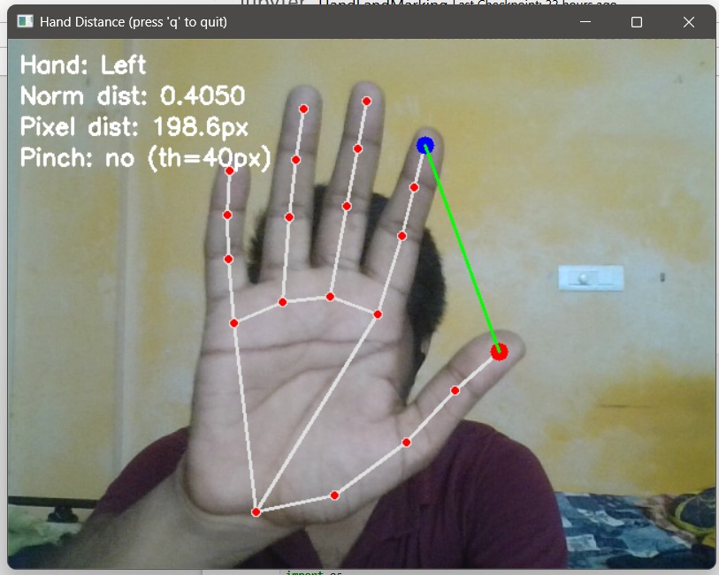
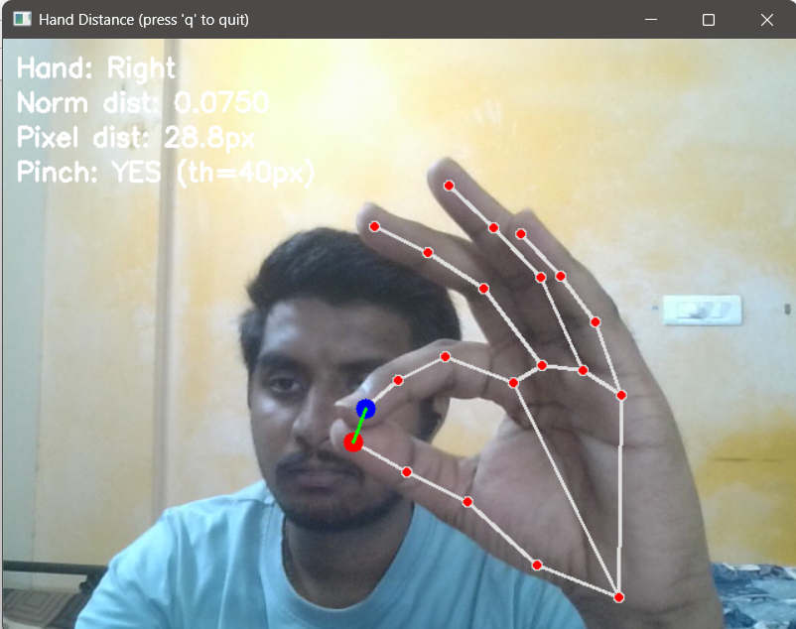
PINCH DETECTION VISUALIZATION AND DISTANCE CALCULATION
REGRESSION CNN MODEL:
Light weight CNN mo0del is used
- less memory usage
- low computation power
- fast
INPUT : Hand Image (RGB)
- Convolutional Layers
- Global average Pooling
- Fully Connected Layers
- Dense layers
OUTPUT: Distance (pixels / norm)
Pinch Detection ( Yes/ No)

Slide 8
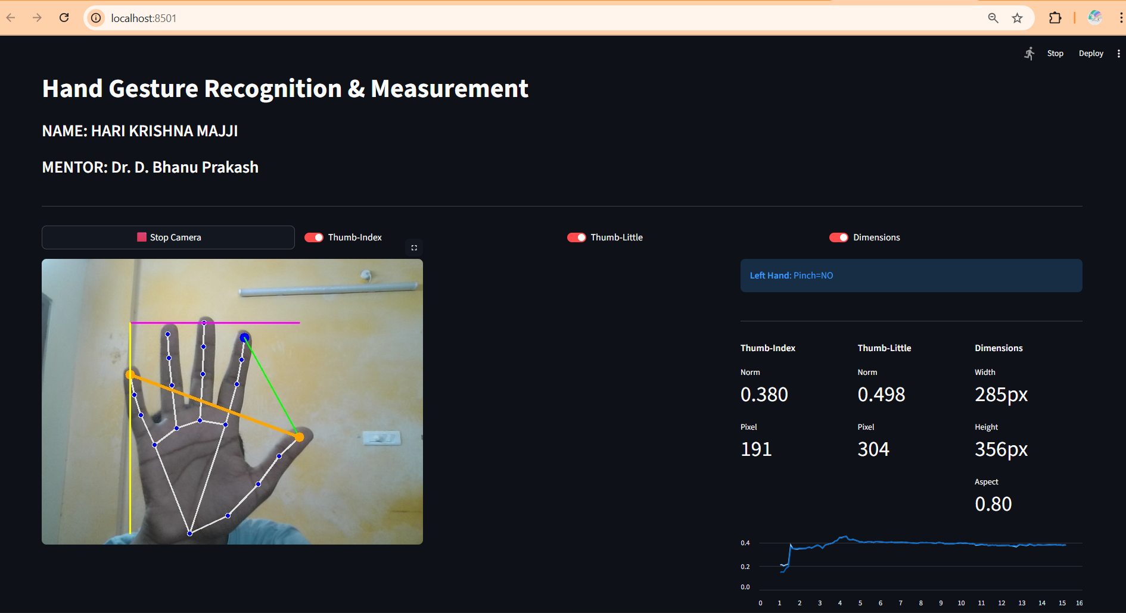
STREAMLIT APP
Interactive Web UI: Converts Python scripts into a web app, replacing basic OpenCV windows with a browser-based interface.
Real-Time Control: Uses buttons and toggles to dynamically control camera and features without restarting.
Live Dashboard: Displays real-time data with clean metrics and live-updating line charts.
State Management: Remembers app settings (like camera on/off) across updates for a smooth user experience.

Slide 9
THANK YOU

